Slide 1
Data Link Control Layer

Slide 2
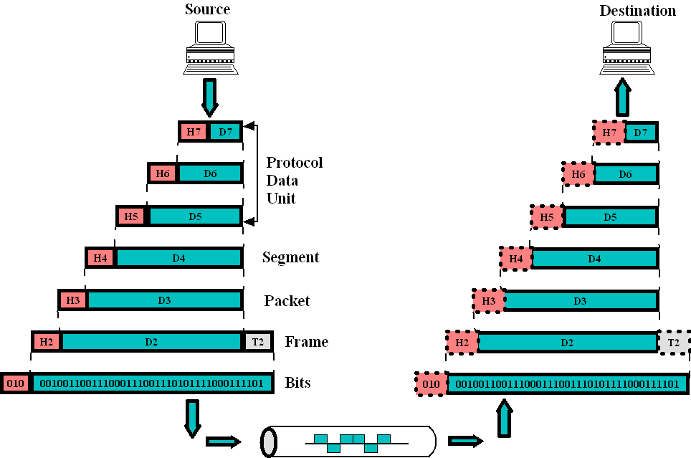
Review: Data Exchange using OSI Model

Slide 3
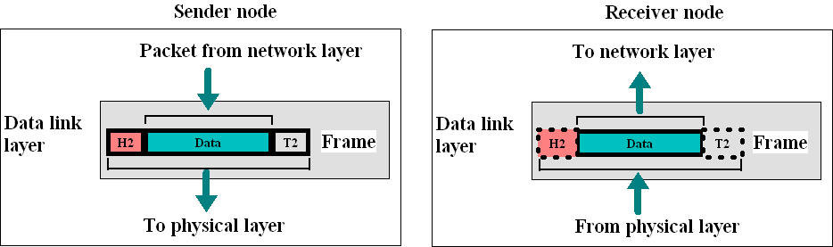
Review: Data link layer
Responsible for frames from one hop to next hop (node)
Framing- Dividing the stream of bits from network layer into frames.
Physical Addressing –Adding headers to a frame to define sender and/or receiver.
Flow Control – To prevent overflow of the receiving mechanism of receiver.
Error Control (Encapsulation)– Detecting and retransmitting lost frames by adding a tail.
Access Control – To determine control over link.

Slide 4
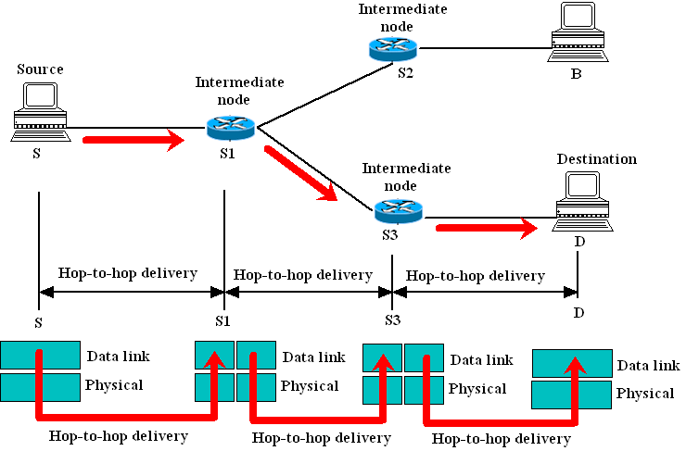
Review: Data link layer: Hop-to-hop delivery

Slide 5
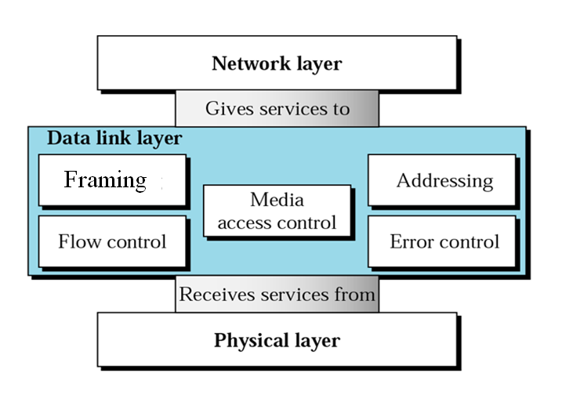
Data link layer services: Summary

Slide 6
FRAMING
The data link layer needs to pack bits into frames, so that each frame is distinguishable from another.
Frame can be fixed size or variable size.
The frame is sent as it is in case fixed size frame.
In variable-size frame, we need a way to define the end of the frame and the beginning of the next.
We can use two approaches: a character-oriented approach and a bit-oriented approach.

Slide 7

A frame in a character-oriented protocol
In character-oriented protocol, data is carried in a 8-bit characters – byte. Mostly popular for text exchange only, e.g. ASCII character.
To separate one frame from the next, an 8-bit flag is added at the beginning and the end of a frame.

Slide 8
A frame in a character-oriented protocol
Issue: This can happen when receiver encounters same pattern as flag in the middle of the data and thinks it has reached the end of the frame.
Solution: Byte-stuffing

Slide 9

Figure Byte stuffing and unstuffing
If flag and escape character are part of the text?
One escape character per flag/escape character needs to be stuffed

Slide 10

Note
Byte stuffing is the process of adding 1 extra byte whenever there is a flag or escape character in the text (data).

Slide 11

Figure A frame in a bit-oriented protocol
In bit-oriented protocol, the data is a sequence of bits to be interpreted.
To separate one frame from another, an 8-bit (a-byte) delimited flag ‘01111110’ is added at the start and end of a frame.

Slide 12
Note
Bit stuffing is the process of adding one extra 0 whenever five consecutive 1s follow a 0 in the data, so that the receiver does not mistake
the pattern 0111110 for a flag.

Slide 13

Figure Bit stuffing and unstuffing

Slide 14

Data link layer control
The data link layer functionality is modelled as two sub-layers.
eg. The logical link control protocol IEEE802.2
The most important responsibilities of this layer are:
Flow control (stop and wait, Sliding window)
Error control. (Automatic Repeat reQuest, ARQ)

Slide 15
FLOW AND ERROR CONTROL
The most important responsibilities of the data link layer are flow control and error control. Collectively, these functions are known as data link control.

Slide 16
Note
Flow control refers to a set of procedures used to restrict the amount of data
that the sender can send before
waiting for acknowledgment.

Slide 17
Note
Error control in the data link layer is based on automatic repeat request, which is the retransmission of data.

Slide 18

Figure Data Link Control Protocols

Slide 19
NOISELESS CHANNELS
Let us first assume we have an ideal channel in which no frames are lost, duplicated, or corrupted. We introduce two protocols for this type of channel.

Slide 20

Figure The design of the simplest protocol with no flow or error control

Slide 21

Example
Figure shows an example of communication using this protocol. It is very simple. The sender sends a sequence of frames without even thinking about the receiver. To send three frames, three events occur at the sender site and three events at the receiver site.

Slide 22

Figure Design of Stop-and-Wait Protocol

Slide 23

Example
Figure shows an example of communication using this protocol. It is still very simple. The sender sends one frame and waits for feedback from the receiver. When the ACK arrives, the sender sends the next frame. Note that sending two frames in the protocol involves the sender in four events and the receiver in two events.

Slide 24
NOISY CHANNELS
Noiseless channels are nonexistent in reality. In noisy channels, frame can be lost, corrupted and out of order. We can use following three protocols for flow and error control:
Stop-and-Wait Automatic Repeat Request (ARQ)
Go-Back-N ARQ
Selective Repeat ARQ

Slide 25
Note
Error correction in Stop-and-Wait ARQ is done by keeping a copy of the sent frame and retransmitting of the frame when the timer expires.

Slide 26
Note
In Stop-and-Wait ARQ, we use sequence numbers to number the frames.
The sequence numbers are based on modulo-2 arithmetic.

Slide 27
Note
In Stop-and-Wait ARQ, the acknowledgment number always announces in modulo-2 arithmetic the sequence number of the next frame expected.

Slide 28

Figure Design of the Stop-and-Wait ARQ Protocol

Slide 29

Example: Stop-and-Wait ARQ
Frame 0 is sent and acknowledged.
Frame 1 is lost and resent after the time-out. The resent frame 1 is acknowledged and the timer stops.
Frame 0 is sent and acknowledged, but the acknowledgment is lost.
The sender has no idea if the frame or the acknowledgment is lost, so after the time-out, it resends frame 0, which is acknowledged.

Slide 30
Note
In the Go-Back-N Protocol, the sequence numbers are modulo 2^{m},
where m is the size of the sequence number field in bits.

Slide 31

Figure Send window for Go-Back-N ARQ

Slide 32
Note
The send window is an abstract concept defining an imaginary box of size 2^{m} − 1 with three variables: Sf, Sn, and S_{size}.

Slide 33
Note
The send window can slide one
or more slots when a valid acknowledgment arrives.

Slide 34

Figure Receive window for Go-Back-N ARQ

Slide 35
Note
The receive window is an abstract concept defining an imaginary box
of size 1 with one single variable R_{n}.
The window slides
when a correct frame has arrived; sliding occurs one slot at a time.

Slide 36
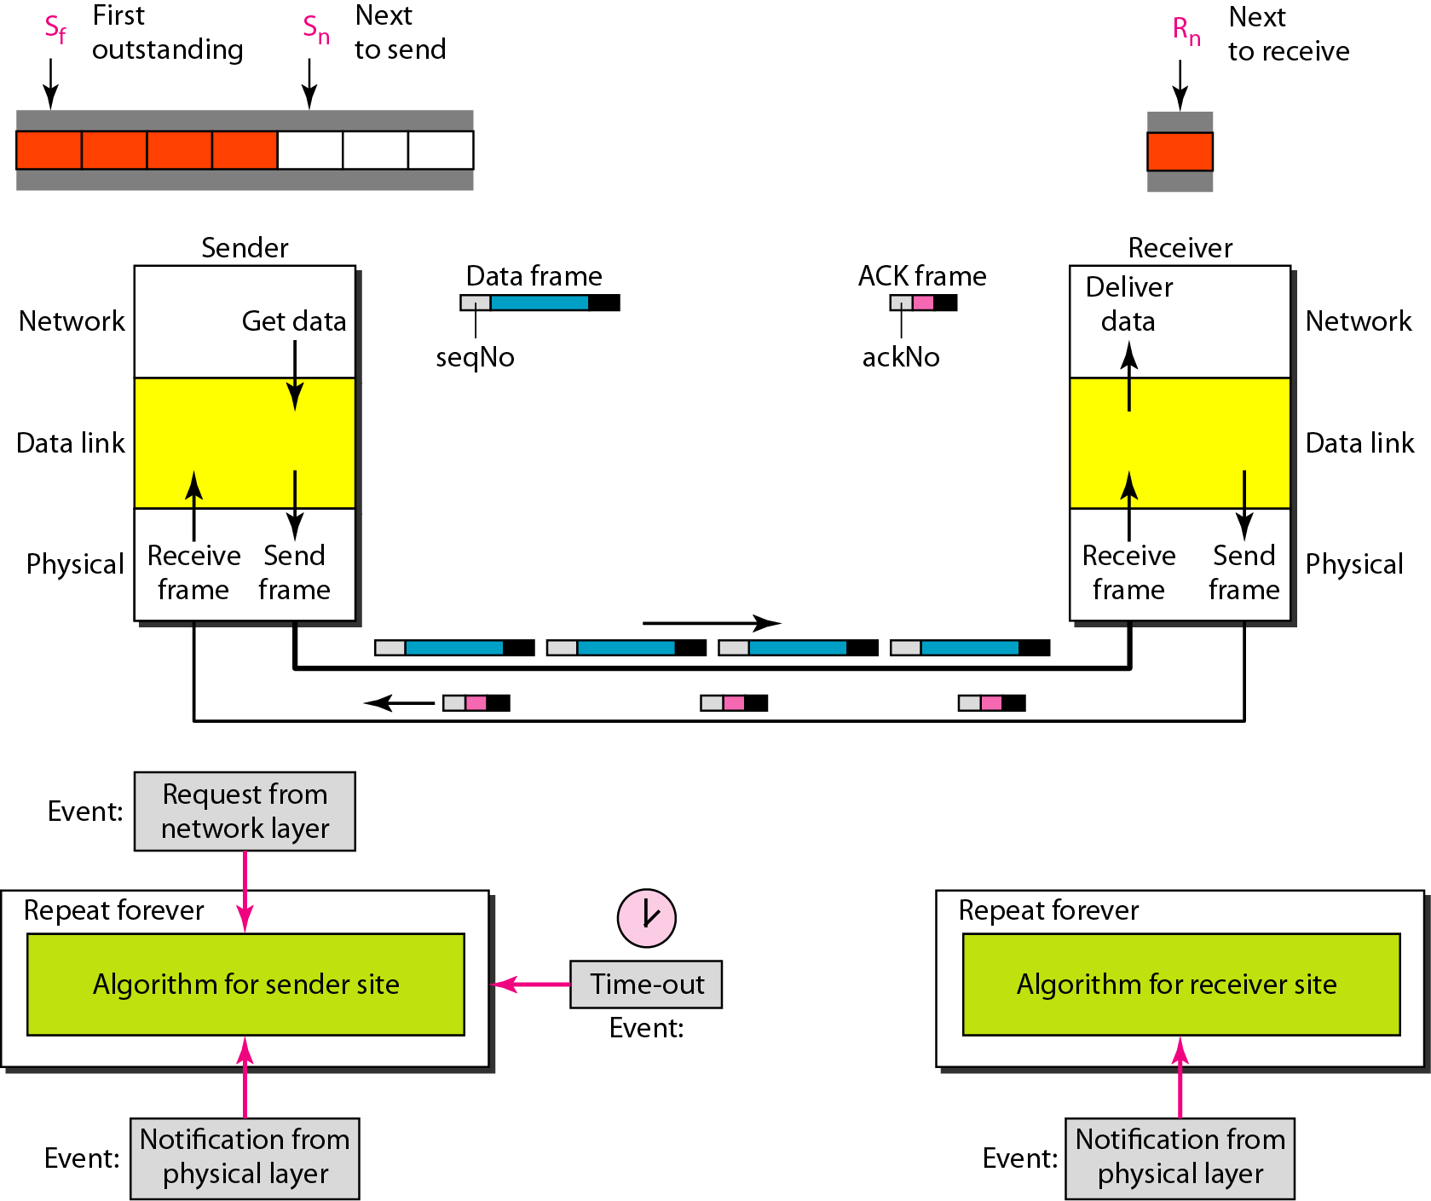
Figure Design of Go-Back-N ARQ

Slide 37

Figure Window size for Go-Back-N ARQ

Slide 38
Note
In Go-Back-N ARQ, the size of the send window must be less than 2^{m};
the size of the receiver window
is always 1.

Slide 39
Example
Next figure shows an example of Go-Back-N. This is an example of a case where the forward channel is reliable, but the reverse is not. No data frames are lost, but some ACKs are delayed and one is lost. The example also shows how cumulative acknowledgments can help if acknowledgments are delayed or lost. After initialization, there are seven sender events. Request events are triggered by data from the network layer; arrival events are triggered by acknowledgments from the physical layer. There is no time-out event here because all outstanding frames are acknowledged before the timer expires. Note that although ACK 2 is lost, ACK 3 serves as both ACK 2 and ACK 3.

Slide 40

Figure Flow diagram when ACK lost in go-back N ARQ

Slide 41
Example
Next figure shows what happens when a frame is lost. Frames 0, 1, 2, and 3 are sent. However, frame 1 is lost. The receiver receives frames 2 and 3, but they are discarded because they are received out of order. The sender receives no acknowledgment about frames 1, 2, or 3. Its timer finally expires. The sender sends all outstanding frames (1, 2, and 3) because it does not know what is wrong. Note that the resending of frames 1, 2, and 3 is the response to one single event. When the sender is responding to this event, it cannot accept the triggering of other events. This means that when ACK 2 arrives, the sender is still busy with sending frame 3.

Slide 42
Example (continued)
The physical layer must wait until this event is completed and the data link layer goes back to its sleeping state. We have shown a vertical line to indicate the delay. It is the same story with ACK 3; but when ACK 3 arrives, the sender is busy responding to ACK 2. It happens again when ACK 4 arrives. Note that before the second timer expires, all outstanding frames have been sent and the timer is stopped.

Slide 43

Figure Flow diagram when data frame lost in go-back N ARQ

Slide 44
Note
Stop-and-Wait ARQ is a special case of Go-Back-N ARQ in which the size of the send window is 1.

Slide 45

Figure Send window for Selective Repeat ARQ

Slide 46

Figure Receive window for Selective Repeat ARQ

Slide 47
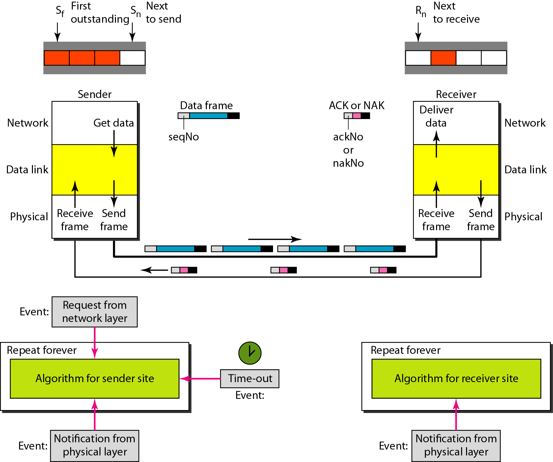
Figure Design of Selective Repeat ARQ

Slide 48

Figure Selective Repeat ARQ, window size

Slide 49
Note
In Selective Repeat ARQ, the size of the sender and receiver window
must be at most one-half of 2^{m}.

Slide 50

Figure Delivery of data in Selective Repeat ARQ

Slide 51
Example
This example shows frame 1 is lost. Next figure shows how Selective Repeat behaves in this case. One main difference is the number of timers. Here, each frame sent or resent needs a timer, which means that the timers need to be numbered (0, 1, 2, and 3). The timer for frame 0 starts at the first request, but stops when the ACK for this frame arrives. The timer for frame 1 starts at the second request, restarts when a NAK arrives, and finally stops when the last ACK arrives. The other two timers start when the corresponding frames are sent and stop at the last arrival event.

Slide 52
Example (continued)
At the receiver site we need to distinguish between the acceptance of a frame and its delivery to the network layer. At the second arrival, frame 2 arrives and is stored and marked, but it cannot be delivered because frame 1 is missing. At the next arrival, frame 3 arrives and is marked and stored, but still none of the frames can be delivered. Only at the last arrival, when finally a copy of frame 1 arrives, can frames 1, 2, and 3 be delivered to the network layer. There are two conditions for the delivery of frames to the network layer: First, a set of consecutive frames must have arrived. Second, the set starts from the beginning of the window.

Slide 53
Example (continued)
Another important point is that a NAK is sent after the second arrival, but not after the third, although both situations look the same. The reason is that the protocol does not want to crowd the network with unnecessary NAKs and unnecessary resent frames. The second NAK would still be NAK1 to inform the sender to resend frame 1 again; this has already been done. The first NAK sent is remembered (using the nakSent variable) and is not sent again until the frame slides. A NAK is sent once for each window position and defines the first slot in the window.

Slide 54
Example (continued)
The next point is about the ACKs. Notice that only two ACKs are sent here. The first one acknowledges only the first frame; the second one acknowledges three frames. In Selective Repeat, ACKs are sent when data are delivered to the network layer. If the data belonging to n frames are delivered in one shot, only one ACK is sent for all of them.

Slide 55

Figure Flow diagram when frame lost in selective repeat request

Slide 56
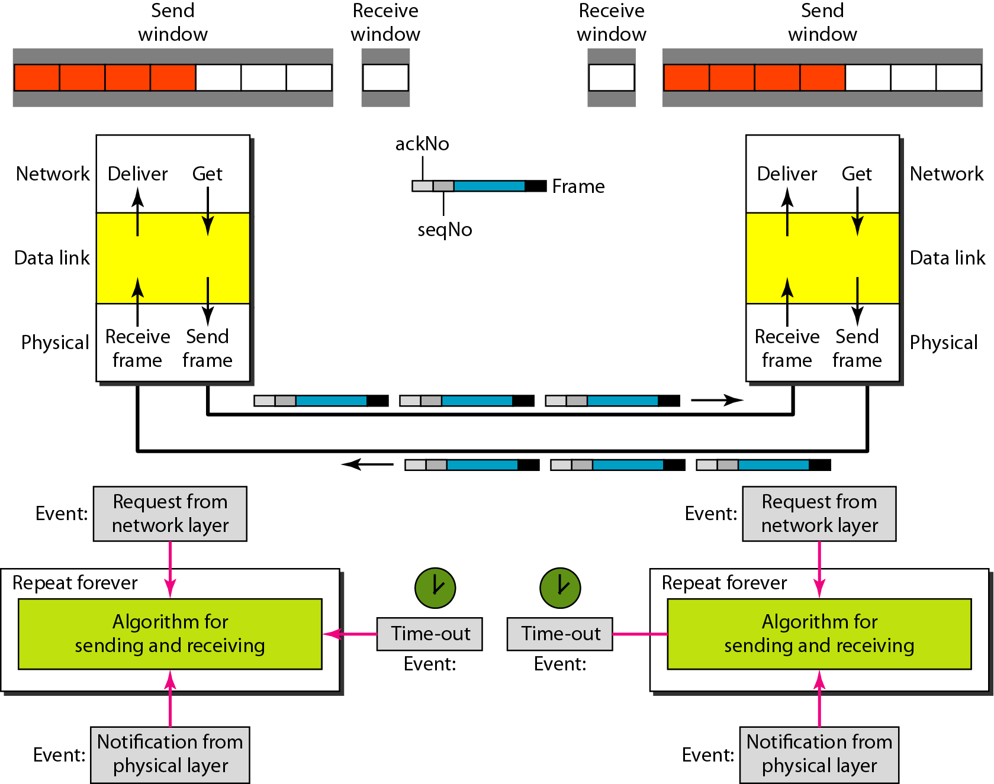
Figure Design of piggybacking in Go-Back-N ARQ

Slide 57

Further Reading
Behrouz Forouzan: Data Communications and Networking, 4th Edition

